Slide 1
CS 201: Design and Analysis of Algorithms
Elementary Graph Algorithms
Breadth first Search

Slide 2
Graphs
Graphs are one of the unifying themes of computer science. A graph G = (V, E) is defined by a set of vertices V , and a set of edges E consisting of ordered or unordered pairs of vertices from V .
Thus a graph G = (V, E)
  V = set of vertices
  E = set of edges = subset of V × V
  Thus |E| = O(|V|²)

Slide 3
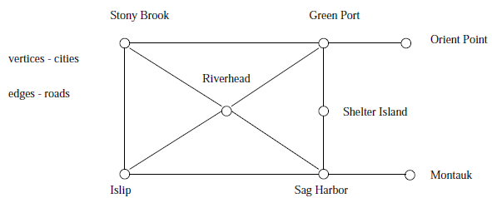
Examples
Road Networks
  In modeling a road network, the vertices may represent the cities or junctions, certain pairs of which are connected by roads/edges.

Slide 4
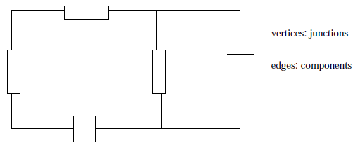
Examples
Electronic Circuits
  In an electronic circuit, with junctions as vertices and components as edges.

Slide 5
Graph Variations
Variations:
  A connected graph has a path from every vertex to every other
  In an undirected graph:
    Edge (u,v) = Edge (v,u)
    No self-loops
A
B
C
D
E
F
G
H
I
J
K
L
M
N
O
P

Slide 6
Graph Variations
  In a directed graph:
    Edge (u,v) goes from vertex u to vertex v, notated u→v
    (u,v) is different from (v,u)
Road networks between cities are typically undirected.
Street networks within cities are almost always directed because of one-way streets.
Most graphs of graph-theoretic interest are undirected.
A
B
C
D
E
F
G
H
I

Slide 7
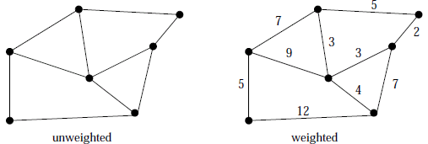
Graph Variations
More variations:
  A weighted graph associates weights with either the edges or the vertices
    E.g., a road map: edges might be weighted with their length, drive-time or speed limit.
  In unweighted graphs, there is no cost distinction between various edges and vertices.

Slide 8
  A multigraph allows multiple edges between the same vertices
    E.g., the call graph in a program (a function can get called from multiple points in another function)

Slide 9
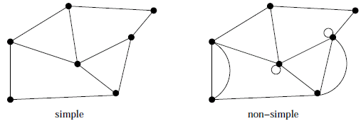
Simple vs. Non-simple Graphs
Certain types of edges complicate the task of working with graphs. A self-loop is an edge (x; x) involving only one vertex.
An edge (x; y) is a multi-edge if it occurs more than once in the graph.
Any graph which avoids these structures is called simple.

Slide 10
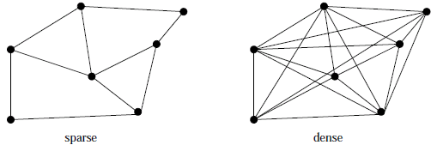
Spars Vs Dense Graphs
Graphs are sparse when only a small fraction of the possible number of vertex pairs actually have edges defined between them.
Graphs are usually sparse due to application-specific constraints.
Road networks must be sparse because of road junctions.

Slide 11
Spars Vs Dense Graphs
Typically dense graphs have a quadratic number of edges while sparse graphs are linear in size.

Slide 12
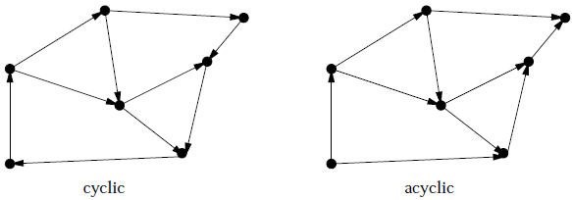
Cyclic vs. Acyclic Graphs
An acyclic graph does not contain any cycles. Trees are connected acyclic undirected graphs.
Directed acyclic graphs are called DAGs. They arise naturally in scheduling problems, where a directed edge (x; y) indicates that x must occur before y.

Slide 13
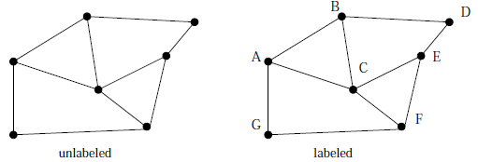
Labeled vs. Unlabeled Graphs
In labeled graphs, each vertex is assigned a unique name or identifier to distinguish it from all other vertices.
An important graph problem is isomorphism testing, determining whether the topological structure of two graphs are in fact identical if we ignore any labels.

Slide 14
Subgraphs
A subgraph S of a graph G is a graph such that
  The edges of S are a subset of the edges of G
A spanning subgraph of G is a subgraph that contains all the vertices of G
Subgraph
Spanning subgraph

Slide 15
Trees and Forests
A tree is an undirected graph T such that
  T is connected
  T has no cycles
  This definition of tree is different from the one of a rooted tree
A forest is an undirected graph without cycles
The connected components of a forest are trees
Tree
Forest

Slide 16
Graph in Applications
Internet: web graphs
  Each page is a vertex
  Each edge represent a hyperlink
  Directed
GPS: highway maps
  Each city is a vertex
  Each freeway segment is an undirected edge
  Undirected
Graphs are ubiquitous in computer science

Slide 17
Representing Graphs
Assume V = {1, 2, …, n}
An adjacency matrix represents the graph as a n x n matrix A:
  A[i, j] = 1 if edge (i, j) ∈ E (or weight of edge)
  = 0 if edge (i, j) ∉ E

Slide 18
Graphs: Adjacency Matrix
Example:
A | 1 | 2 | 3 | 4
1
2 |  | ? ?
3
4
1
a
2
d
4
b
c
3

Slide 19
Graphs: Adjacency Matrix
Example:
A | 1 | 2 | 3 | 4
1 | 0 | 1 | 1 | 0
2 | 0 | 0 | 1 | 0
3 | 0 | 0 | 0 | 0
4 | 0 | 0 | 1 | 0
1
a
2
d
4
b
c
3

Slide 20
Graphs: Adjacency Matrix
The adjacency matrix is a dense representation
  Usually too much storage for large graphs
  But can be very efficient for small graphs
Most large interesting graphs are sparse
  E.g., planar graphs, in which no edges cross
  For this reason the adjacency list is often a more appropriate respresentation

Slide 21
Graphs: Adjacency List
Adjacency list: for each vertex v ∈ V, store a list of vertices adjacent to v
Example:
  Adj[1] = {2,3}
  Adj[2] = {3}
  Adj[3] = {}
  Adj[4] = {3}
Variation: can also keep
a list of edges coming into vertex
1
2
4
3

Slide 22
Graphs: Adjacency List
How much storage is required?
  The degree of a vertex v in an undirected graph = # incident edges
    Directed graphs have in-degree, out-degree
  For directed graphs, # of items in adjacency lists is
  Σ out-degree(v) = |E|
  takes Θ(V + E) storage
  For undirected graphs, # items in adj lists is
  Σ degree(v) = 2 |E|
  also Θ(V + E) storage
So: Adjacency lists take O(V+E) storage

Slide 23
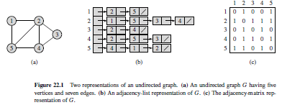
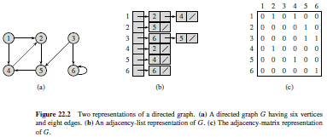
Graph Representation

Slide 24
Google Problem:Graph Searching
How to search and explore in the Web Space?
How to find all web-pages and all the hyperlinks?
  Start from one vertex “www.google.com”
  Systematically follow hyperlinks from the discovered vertex/web page
  Build a search tree along the exploration

Slide 25
General Graph Searching
Given: a graph G = (V, E), directed or undirected
Goal: methodically explore every vertex and every edge
Ultimately: build a tree on the graph
  Pick a vertex as the root
  Choose certain edges to produce a tree
  Note: might also build a forest if graph is not connected

Slide 26
Breadth-First Search
“Explore” a graph, turning it into a tree
  One vertex at a time
  Expand frontier of explored vertices across the breadth of the frontier
Builds a tree over the graph
  Pick a source vertex to be the root
  Find (“discover”) its children, then their children, etc.

Slide 27
Breadth-First Search
Again will associate vertex “colors” to guide the algorithm
  White vertices have not been discovered
    All vertices start out white
  Grey vertices are discovered but not fully explored
    They may be adjacent to white vertices
  Black vertices are discovered and fully explored
    They are adjacent only to black and gray vertices
Explore vertices by scanning adjacency list of grey vertices

Slide 28
A
B
C
D
0
E
F
G
H
I
J
K
L
M
N
O
P

Slide 29
A
B
C
D
0
1
E
F
1
G
H
1
I
J
K
L
M
N
O
P

Slide 30
A
B
C
D
0
1
2
E
F
1
G
H
1
2
I
J
K
L
M
N
O
P

Slide 31
A
B
C
D
0
3
1
2
E
F
1
G
H
1
3
3
2
I
J
K
L
M
N
O
P
3
3

Slide 32
A
B
C
D
0
3
1
2
E
F
1
G
H
1
3
4
3
2
I
J
K
4
L
4
M
N
O
P
3
3

Slide 33
A
B
C
D
0
3
1
2
E
F
1
G
H
1
3
4
3
2
I
J
K
4
L
4
5
M
N
O
P
3
3
5

Slide 34
A
B
C
D
0
3
1
2
E
F
1
G
H
1
3
4
3
2
I
J
K
4
L
4
5
M
N
O
P
3
3
5

Slide 35
A
B
C
D
0
3
1
2
E
F
1
G
H
1
3
4
3
2
I
J
K
4
L
4
5
M
N
O
P
3
3
5

Slide 36
Breadth-First Search
BFS(G, s) {
initialize vertices;
Q = {s}; // Q is a queue (duh); initialize to s
while (Q not empty) {
u = RemoveTop(Q);
for each v ∈ u->adj {
if (v->color == WHITE)
v->color = GREY;
v->d = u->d + 1;
v->p = u;
Enqueue(Q, v);
}
u->color = BLACK;
}
}

Slide 37
Breadth-First Search: Example
r
s
t
u
∞
∞
∞
∞
∞
∞
∞
∞
v
w
x
y

Slide 38
Breadth-First Search: Example
r
s
t
u
∞
0
∞
∞
∞
∞
∞
∞
v
w
x
y
Q:
s

Slide 39
Breadth-First Search: Example
r
s
t
u
1
0
∞
∞
∞
1
∞
∞
v
w
x
y
Q:
w
r

Slide 40
Breadth-First Search: Example
r
s
t
u
1
0
2
∞
∞
1
2
∞
v
w
x
y
Q:
r
t
x

Slide 41
Breadth-First Search: Example
r
s
t
u
1
0
2
∞
2
1
2
∞
v
w
x
y
Q:
t
x
v

Slide 42
Breadth-First Search: Example
r
s
t
u
1
0
2
3
2
1
2
∞
v
w
x
y
Q:
x
v
u

Slide 43
Breadth-First Search: Example
r
s
t
u
1
0
2
3
2
1
2
3
v
w
x
y
Q:
v
u
y

Slide 44
Breadth-First Search: Example
r
s
t
u
1
0
2
3
2
1
2
3
v
w
x
y
Q:
u
y

Slide 45
Breadth-First Search: Example
r
s
t
u
1
0
2
3
2
1
2
3
v
w
x
y
Q:
y

Slide 46
Breadth-First Search: Example
r
s
t
u
1
0
2
3
2
1
2
3
v
w
x
y
Q:
Ø

Slide 47
BFS: The Code Again
BFS(G, s) {
initialize vertices;
Q = {s};
while (Q not empty) {
u = RemoveTop(Q);
for each v ∈ u->adj {
if (v->color == WHITE)
v->color = GREY;
v->d = u->d + 1;
v->p = u;
Enqueue(Q, v);
}
u->color = BLACK;
}
}
Touch every vertex: O(V)
u = every vertex, but only once
So v = every vertex that appears in some other vert’s adjacency list
What will be the running time?
Total running time: O(V+E)

